Slide 1
THE CASE OF KEEL BONE FRACTURES IN LAYING HENS
Animal Welfare Intergroup meeting at 27th of January 2022
Mia Bonnichsen
Veterinarian & Master of Welfare Assesment in Animal Livestock Production
ANIMAL PROTECTION DENMARK

Slide 2
“Painful fractures: Large eggs push small hens to the breaking point
EGGS: The majority of laying hens in Denmark suffer from keel bone fractures, a new study conducted at the University of Copenhagen reveals. The fractures appear to be the result of disproportionately large eggs, which push the hen’s body to the breaking point. The researchers behind the new study call it a huge global problem for animal welfare.”

Slide 3
85 % of the hens have fractures of the keel bone !

Slide 4
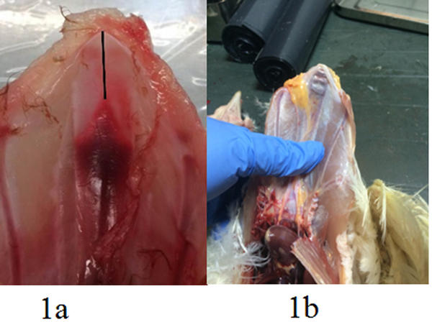
Fig 1.
Keel bone fractures at the tip of the keel bone.
Fractures seems to develop from the inside
Thøfner I, Hougen HP, Villa C, Lynnerup N, Christensen JP (2020) Pathological characterization of keel bone fractures in laying hens does not support external trauma as the underlying cause. PLOS ONE 15(3): e0229735. https://doi.org/10.1371/journal.pone.0229735
https://journals.plos.org/plosone/article?id=10.1371/journal.pone.0229735

Slide 5
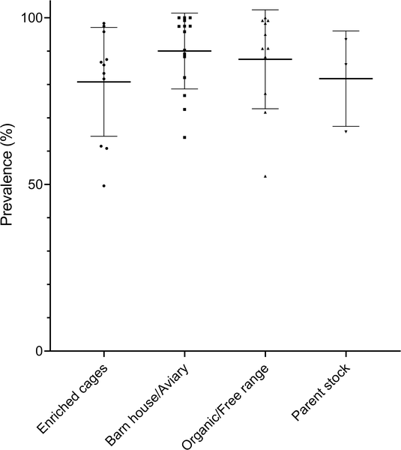
Fig 1. Scatter plot of the flock prevalence of KBF within each production system.
Around 85% have fractures
Many had 4 or more fractures each
Thøfner ICN, Dahl J, Christensen JP (2021) Keel bone fractures in Danish laying hens: Prevalence and risk factors. PLOS ONE 16(8): e0256105. https://doi.org/10.1371/journal.pone.0256105
https://journals.plos.org/plosone/article?id=10.1371/journal.pone.0256105

Slide 6
What increases the risk of fractures of the keel bone?
Small birds
Large eggs at onset of lay
Low age of onset of lay
The smaller the bird and the larger the egg – the more fractures
Present breeding goals:
small hens and high egg yield….

Slide 7
Wake-up call?
Animals are sentient beeings
Unacceptable to let the animals break their bones in order to lay eggs
Breeding goals must include animal welfare
Economy vs. Animal welfare
International problem

Slide 8
Legislation on farm animals
EU COUNCIL DIRECTIVE 98/58/EC of 20 July 1998 concerning the protection of animals kept for farming purposes, ANNEX 21.
“No animal shall be kept for farming purposes unless it can reasonably be expected, on the basis of its genotype or phenotype, that it can be kept without detrimental effect on its health or welfare.”

Slide 9
What have we done so far..
Phase out welfare label on eggs …
Meeting with the Danish egg industry about solutions for laying hens.
Public consultation of EU animal welfare legislation

Slide 10
Thank you for listening ..

