Slide 1
The constant threat of bird flu viruses to humans and farmed birds
Thijs Kuiken
Intergroup on the welfare and conservation of animals, 24 March 2022

Slide 2
Highly pathogenic influenza virus (bird flu virus) normally not in nature: conversion takes place in poultry (Horimoto & Kawaoka 2005 Nature Rev Microbiol)
Notes:
Illustration of localized low pathogenic avian influenza (LPAI) infection versus systemic HPAI infection. Adapted by permission from Macmillan Publishers Ltd: [Nature Reviews Microbiology] ‘Influenza: lessons from past pandemics, warnings from current incidents’ copyright 2005.
The switch from an LPAI phenotype to the HPAI phenotype of these H5 and H7 influenza A viruses is achieved by the introduction of basic amino acid residues into the HA₀ cleavage site by substitution or insertion, resulting in the so-called multibasic cleavage site (MBCS), which facilitates systemic virus replication (4, 5, 14, 44). The cleavage of the HA₀ of LPAI viruses is restricted to trypsin-like proteases which recognize the XXX(R/K)↓G cleavage motif, where the downward arrow indicates the site of cleavage. Replication of these LPAI viruses is therefore restricted to sites in the host where these enzymes are expressed, i.e., the respiratory and intestinal tract (32, 38). The introduction of an RX(R/K)R↓G or R(R/K)XR↓G minimal MBCS motif into the H5 and H7 subtype viruses facilitates the recognition and cleavage of the HA₀ by ubiquitous proprotein convertases, such as furin (20, 32, 41, 45).
The HA trimer is synthesized as inactive precursor protein HA0 to prevent any premature and unwanted fusion activity and must be cleaved by host proteases in order to be infectious.

Slide 3
Increase in HPAI outbreaks linked to increase in poultry production (Reperant et al. 2012 Curr Top Microbiol Immunol.)

Slide 4
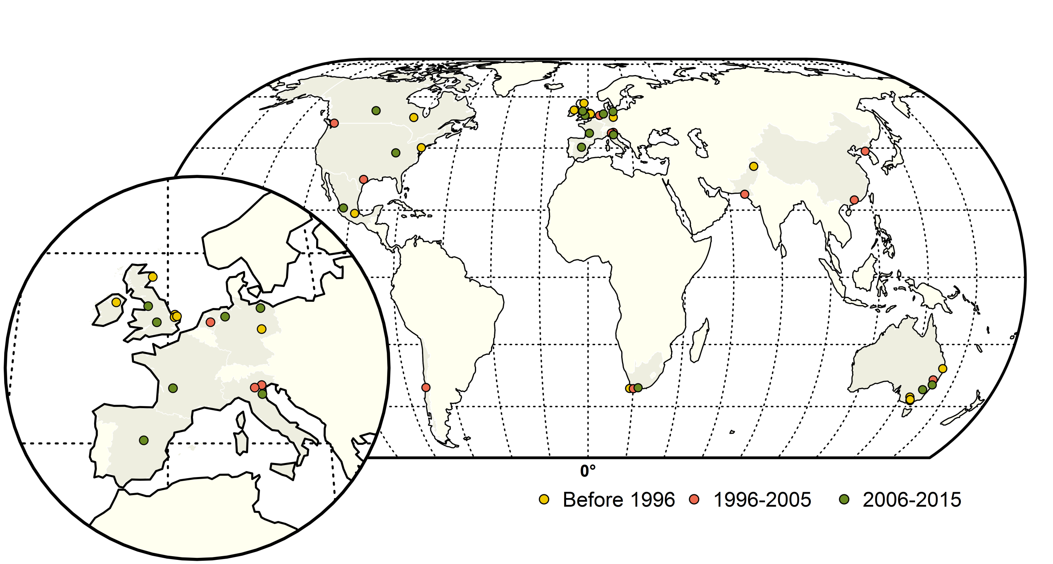
Conversions to HPAI virus mostly happen in intensive production systems (36/39), and mostly in Europe (14/39) (Dhingra et al. 2015, Front Vet Sci)
Notes:
Map of highly pathogenic avian influenza (HPAI) subtype H5 and H7 conversions during three time periods; yellow (before 1996), red (1996–2005) and green (2006–2015).
Spatially, a large majority of the conversions occurred in Europe (n = 14), followed by the Americas (n = 9), Australia (n = 7), Africa (n = 3) and Asia (n = 4).
In terms of host species and production systems, conversion events are predominant in intensive production systems with conversion events found in commercial chicken farms (n = 25), followed by commercial turkey farms (n = 8), ostrich farms (n = 2) and commercial geese farms (n = 1). Backyard farms only reported HPAI conversions on two instances: in 1997, in Italy with an HPAI H5N2 virus, and in France with an HPAI H5N1 virus. The only instance of a conversion being documented in wild birds was the large die-off of wild terns caused by HPAI H5N3 in 1961, off the coast of South Africa.
Dhingra MS, Artois J, Dellicour S, Lemey P, Dauphin G, Von Dobschuetz S, Van Boeckel TP, Castellan DM, Morzaria S and Gilbert M (2018) Geographical and Historical Patterns in the Emergences of Novel Highly Pathogenic Avian Influenza (HPAI) H5 and H7 Viruses in Poultry. Front. Vet. Sci. 5:84. doi: 10.3389/fvets.2018.00084

Slide 5
Current HPAI virus (H5 HPAI, Goose/Guangdong lineage) now adapted to circulation in wild birds > serious problem (Kuiken & Bodewes 2018 Adv Virus Res)
Traditional bird flu epidemiology
Current epidemiology, H5 bird flu Gs/Gd lineage

Slide 6
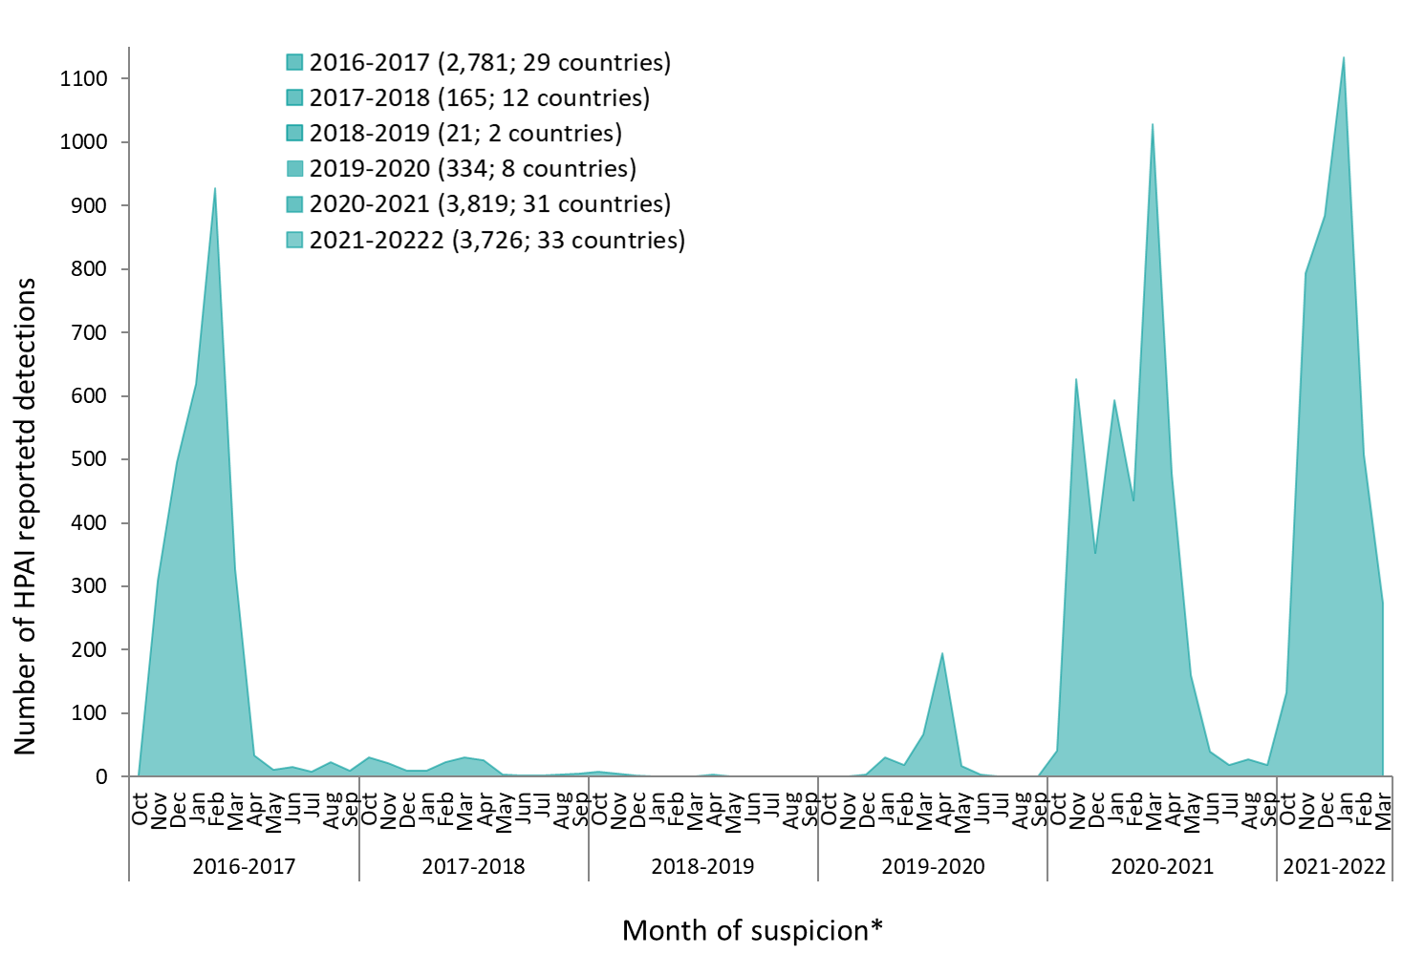
Magnitude H5 HPAI Gs/Gd outbreaks in Europe, 2016-2022 (EFSA in prep.)
Notes:
Distribution of the number of HPAI virus detections reported in Europe in the seasons 2016–2017, 2017–2018, 2018–2019, 2019–2020 and 2020–2021 by month of suspicion, 1 October 2016 to 8 December 2021 (7,948)

Slide 7
HPAI Gs/Gd H5NX in Europe, 2021 to 2022 (1 March): 3276 cases in domestic and wild birds, over 10 million birds killed, 33 countries (EFSA in prep.)

Slide 8
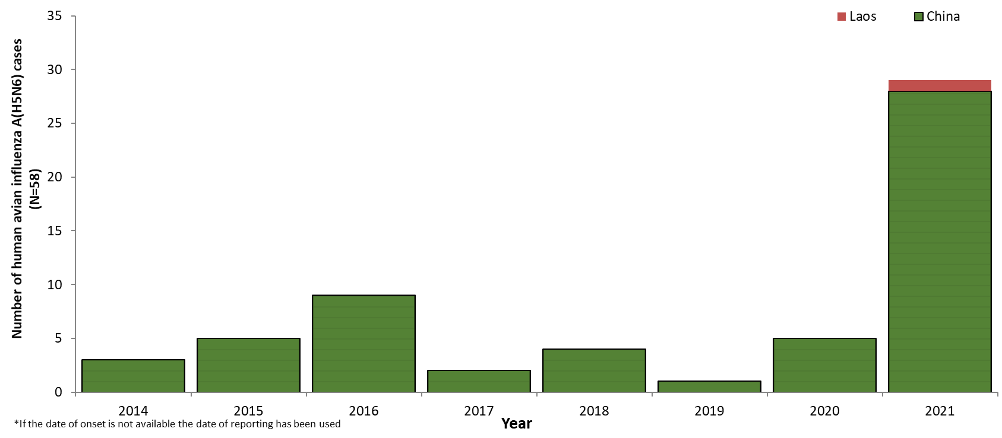
Human cases of H5 HPAI Gs/Gd virus infection
2013-2021: 863 human Gs/Gd H5 infections (456 fatal) in Europe, Africa, Asia (WHO, 2021)
2014-2022: 58 human Gs/Gd H5N6 clade 2.3.4.4 infections (25 fatal) in China and Laos (EFSA in prep.)

Slide 9
Avian influenza, a new threat to public health in Europe? (Adlhoch et al. 2022 Clinical Microbiol Infection)
Transmission to humans (including UK and Russia)
Transmission to wild and domestic mammals
Sporadic identification of viruses with mutations associated with mammalian adaptation
Ongoing evolution with high diversification and reassortment events
Detection of multiple avian influenza viruses in farms and live animal markets
Widespread distribution of reassorted viruses in animals and humans globally
Concern that bird flu viruses further evolve to become efficiently transmissible among humans, and so start a new flu pandemic.

Slide 10
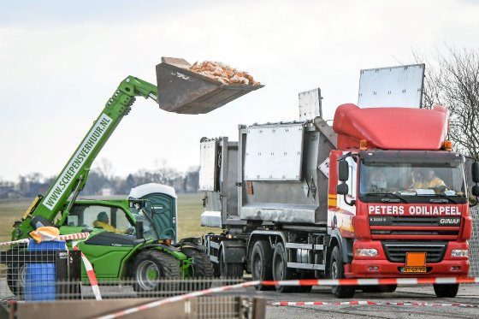
Current measures to deal with HPAI in poultry (EFSA 2017)
Surveillance
Biosecurity
Culling
But: inadequate to stop outbreaks

Slide 11
Recommended measures from Dutch expert group on zoonoses (Bekedam et al. 2021, EFSA 2021)
Strengthen the health of the environment, animals, and people from a One Health approach.
Achieve the fullest possible monitoring of wild bird populations and their (zoonotic) microbes.
Implement an annual independent biosecurity check for poultry farms.
Encourage the availability and international acceptance of effective vaccines for HPAI in poultry farms.
Offer an annual influenza vaccine to all livestock farmers and others who regularly come into contact with poultry, wild birds or pigs.
Reduce the density of poultry farms and the number of animals to prevent the efficient transmission of zoonotic pathogens between poultry farms.
Aim for the absence of poultry farms in areas with abundant waterfowl (no new farms, reduction of existing farms).

Slide 12
Requests to European Parliament members
Treat HPAI problem as matter of urgency
For the broader public good, overcome opposition from those with interests vested in the status quo
Take One Health approach regarding poultry sector in Europe
Improved human health and welfare AND
Improved animal health and welfare AND
Improved environmental health and resilience

Slide 13
References
Adlhoch C, Baldinelli F, Fusaro A, Terregino C. Avian influenza, a new threat to public health in Europe? Clin Microbiol Infect. 2022 Feb;28(2):149-151. doi: 10.1016/j.cmi.2021.11.005.
Bekedam, 2021. Zoönosen in het vizier: rapport van de expertgroep zoönosen. https://www.tweedekamer.nl/kamerstukken/brieven_regering/detail/2021Z12901/2021D27686
Bodewes R, Kuiken T. Changing Role of Wild Birds in the Epidemiology of Avian Influenza A Viruses. Adv Virus Res. 2018;100:279-307. doi: 10.1016/bs.aivir.2017.10.007.
Dhingra MS, Artois J, Dellicour S, Lemey P, Dauphin G, Von Dobschuetz S, Van Boeckel TP, Castellan DM, Morzaria S and Gilbert M (2018) Geographical and Historical Patterns in the Emergences of Novel Highly Pathogenic Avian Influenza (HPAI) H5 and H7 Viruses in Poultry. Front. Vet. Sci. 5:84. doi: 10.3389/fvets.2018.00084
EFSA AHAW Panel (EFSA Panel on Animal Health and Welfare), More S, BicoutD, Bøtner A, Butterworth A, Calistri P, Depner K, Edwards S, Garin-Bastuji B, Good M, GortazarSchmidt C, Michel V, Miranda MA, Nielsen SS, Raj M, Sihvonen L, Spoolder H, Thulke H-H, Velarde A,Willeberg P, Winckler C, Breed A, Brouwer A, Guillemain M, Harder T, Monne I, Roberts H, Baldinelli F,Barrucci F, Fabris C, Martino L, Mosbach-Schulz O, Verdonck F, Morgado J and Stegeman JA, 2017.Scientific opinion on avian influenza. EFSA Journal 2017;15(10):4991, 233 pp.https://doi.org/10.2903/j.efsa.2017.4991
EFSA (European Food Safety Authority), ECDC (European Centre for Disease Prevention and Control),EURL (European Reference Laboratory forAvian Influenza), Adlhoch C,Fusaro A, Gonzales JL, Kuiken T,Marangon S, NiqueuxÉ, Staubach C, Terregino C, Aznar I, Muñoz Guajardo Iand Baldinelli F, 2021. Scientific report: Avian influenza overview September–December 2021.94pp.https://doi.org/10.2903/j.efsa.2021.7108
Horimoto T, Kawaoka Y. Influenza: lessons from past pandemics, warnings from current incidents. Nat Rev Microbiol. 2005 Aug;3(8):591-600. doi: 10.1038/nrmicro1208.
Reperant, L.A., Cornaglia, G., Osterhaus , A.D.M.E. (2012). The Importance of Understanding the Human–Animal Interface. In: Mackenzie, J., Jeggo, M., Daszak, P., Richt, J. (eds) One Health: The Human-Animal-Environment Interfaces in Emerging Infectious Diseases. Current Topics in Microbiology and Immunology, vol 365. Springer, Berlin, Heidelberg. https://doi.org/10.1007/82_2012_269
WHO 2021: https://cdn.who.int/media/docs/default-source/influenza/h5n1-human-case-cumulative-table/2021_dec_tableh5n1.pdf?sfvrsn=59e10798_9&download=true

